Slide 1
Activity Time Remember make time everyday for FUN !!!
Keeping busy with Mrs. Henniger

Slide 2
Click on the Safer Smarter Kids Activity Page to complete your own Powerful Flower

Slide 3
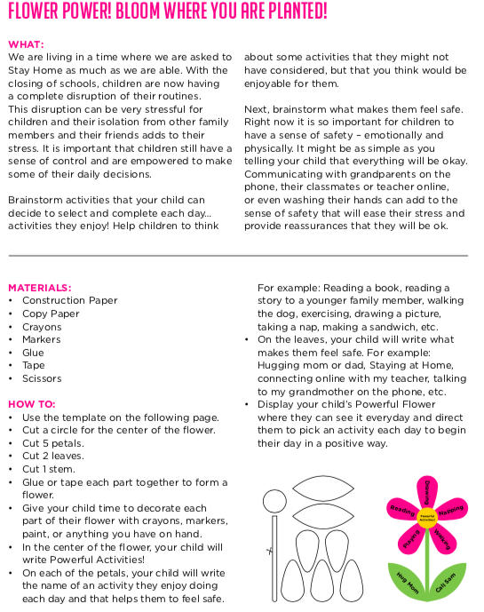
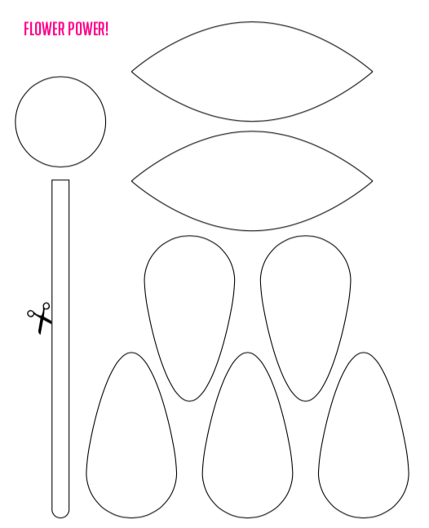

Slide 4
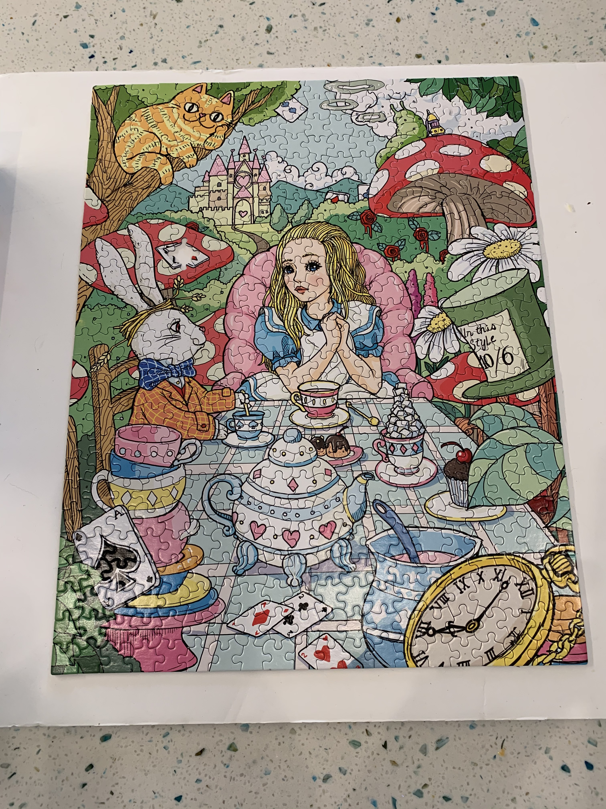
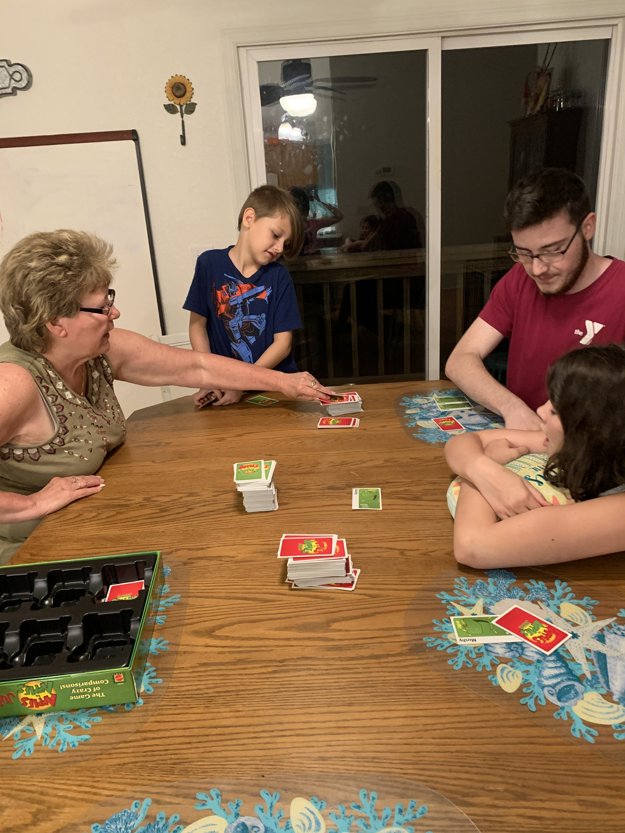
What are your favorite family activities ?
Board games and puzzles
are some of my favorites
What is your favorite board
game to play ?
Mine is Apples to Apples
What is the largest puzzle
you have ever completed?
So far for me 1000 pieces

Slide 5
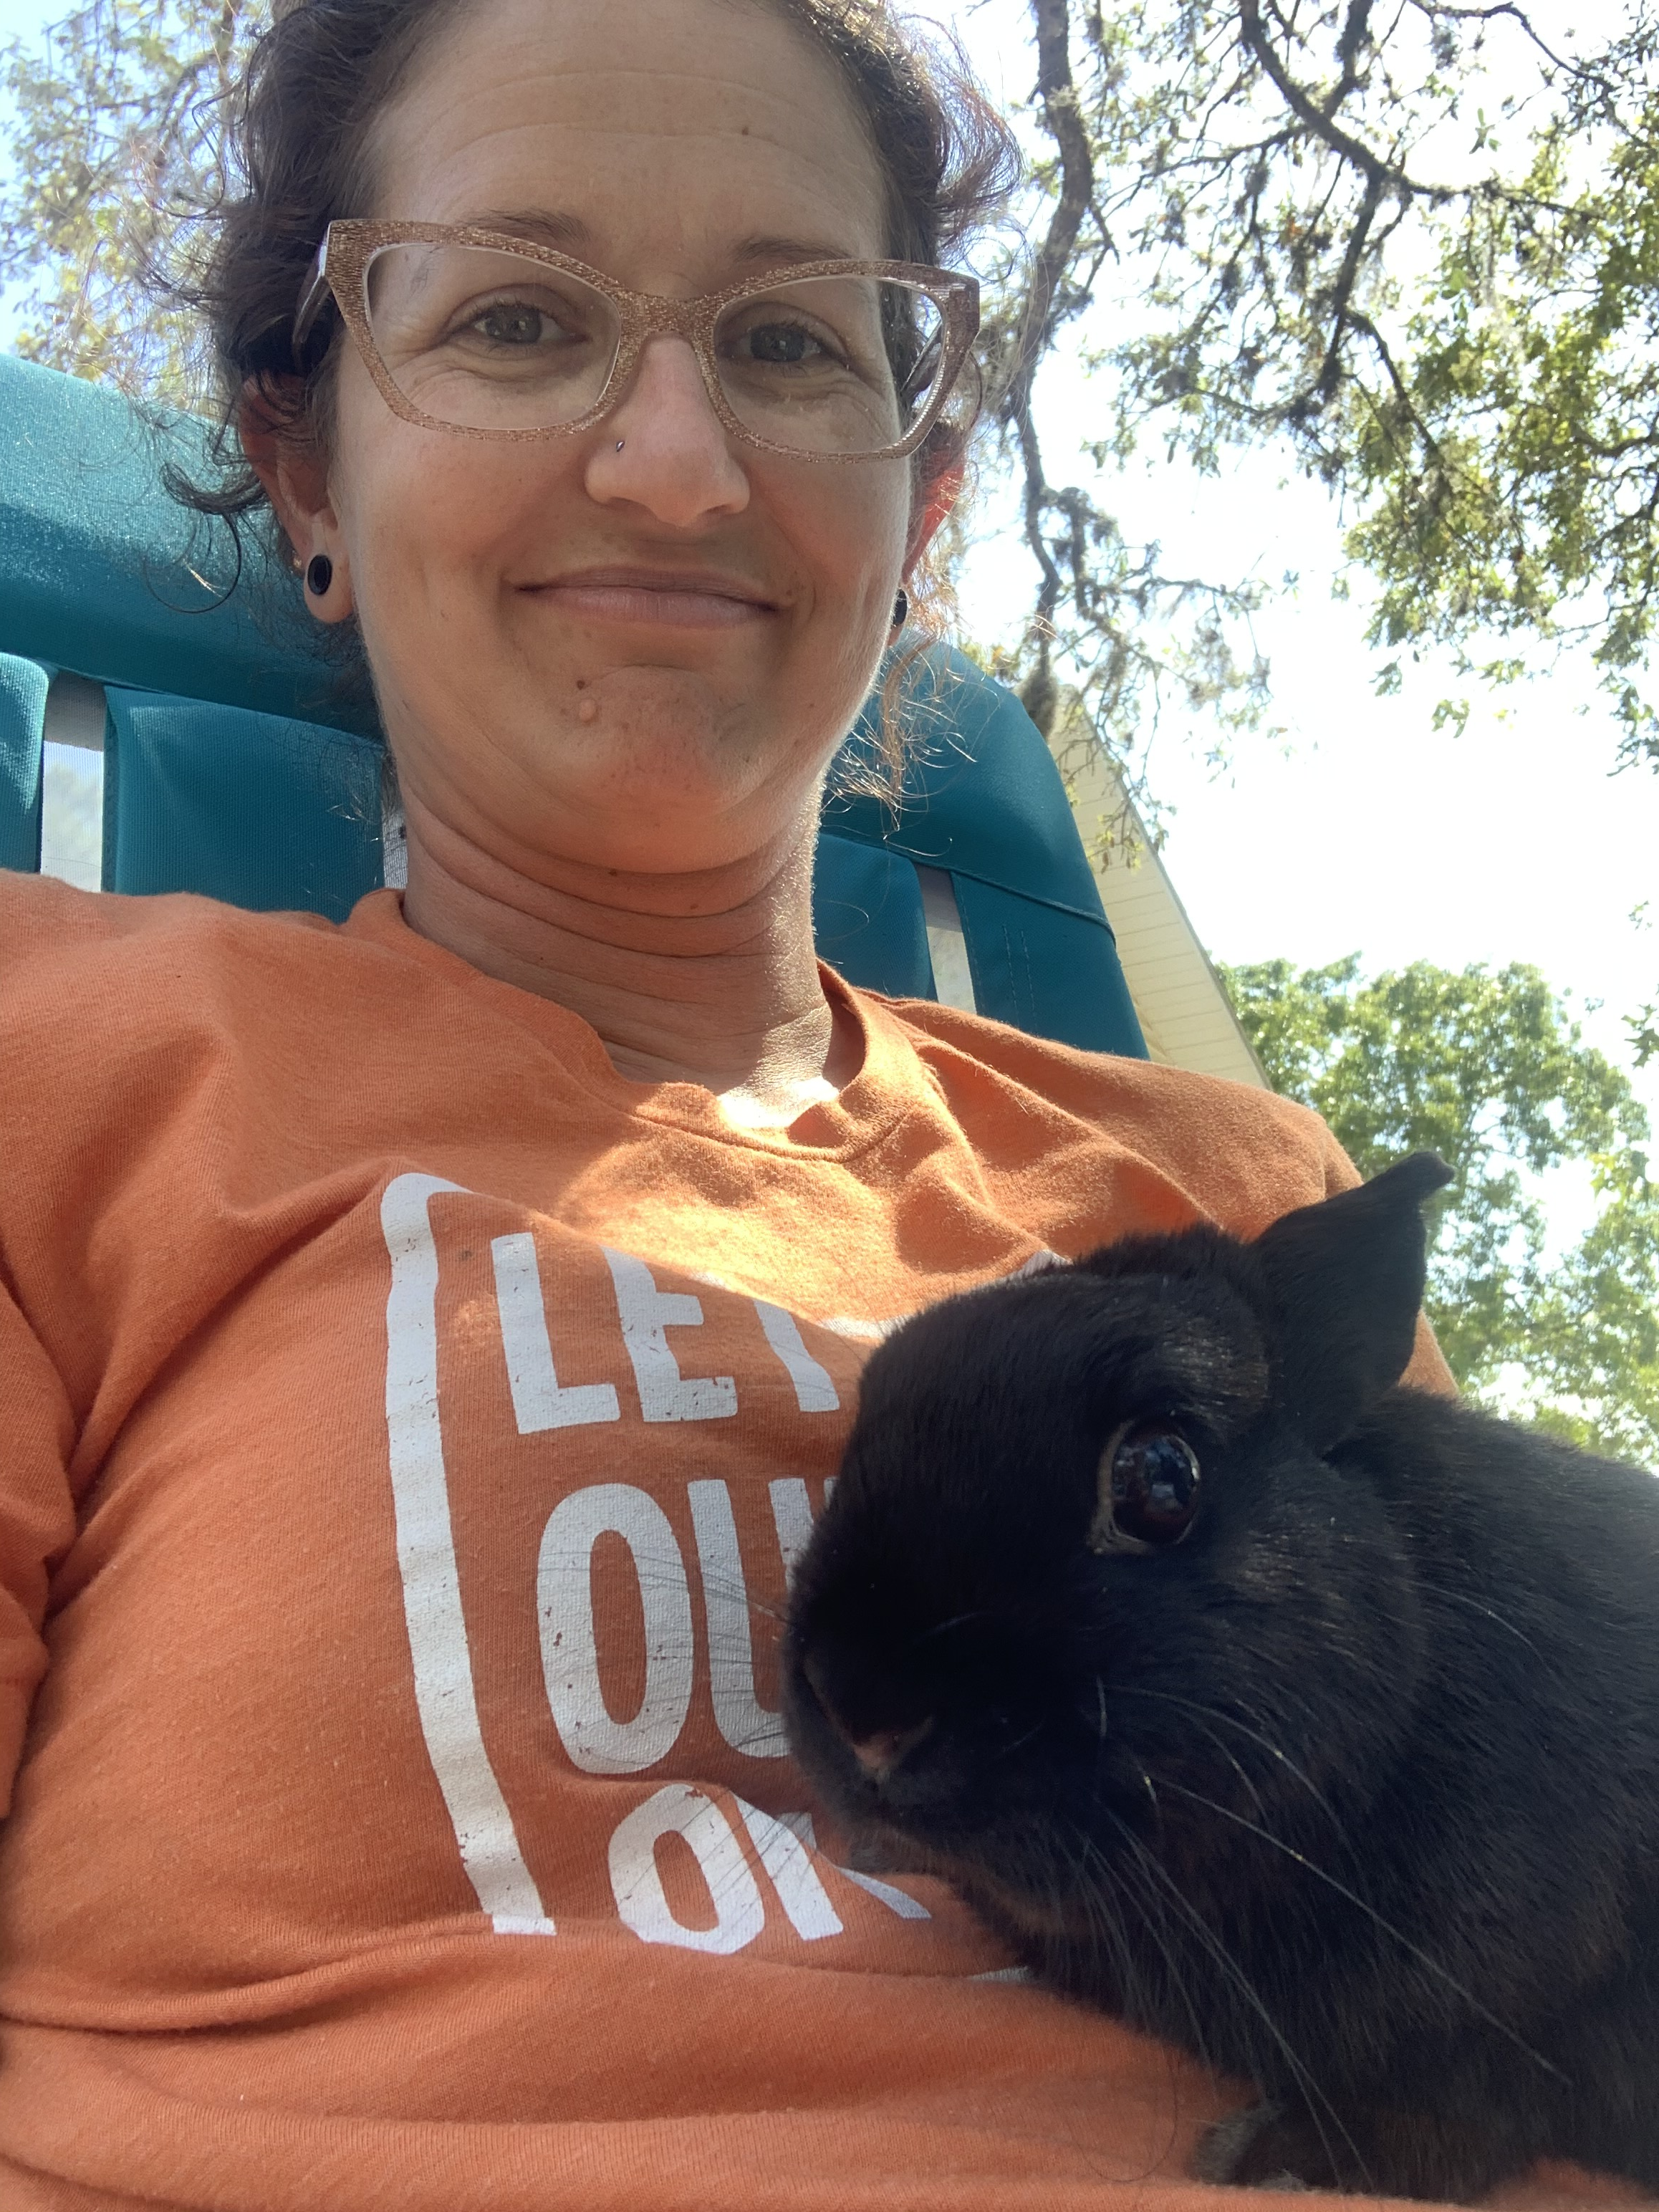
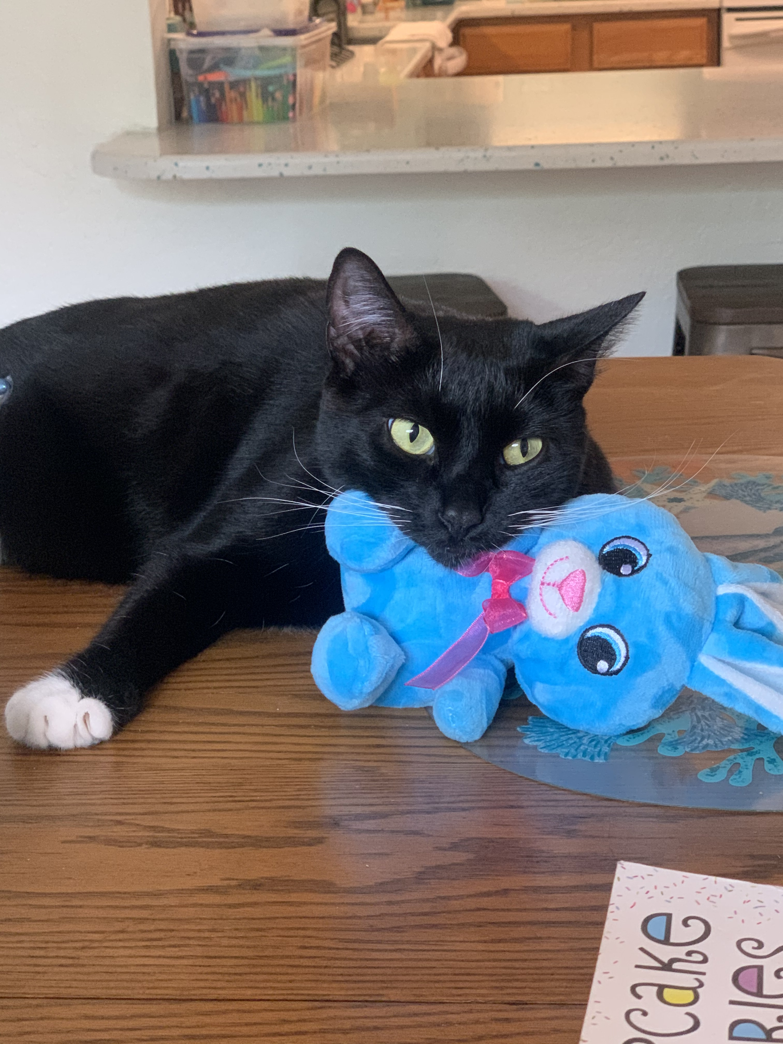
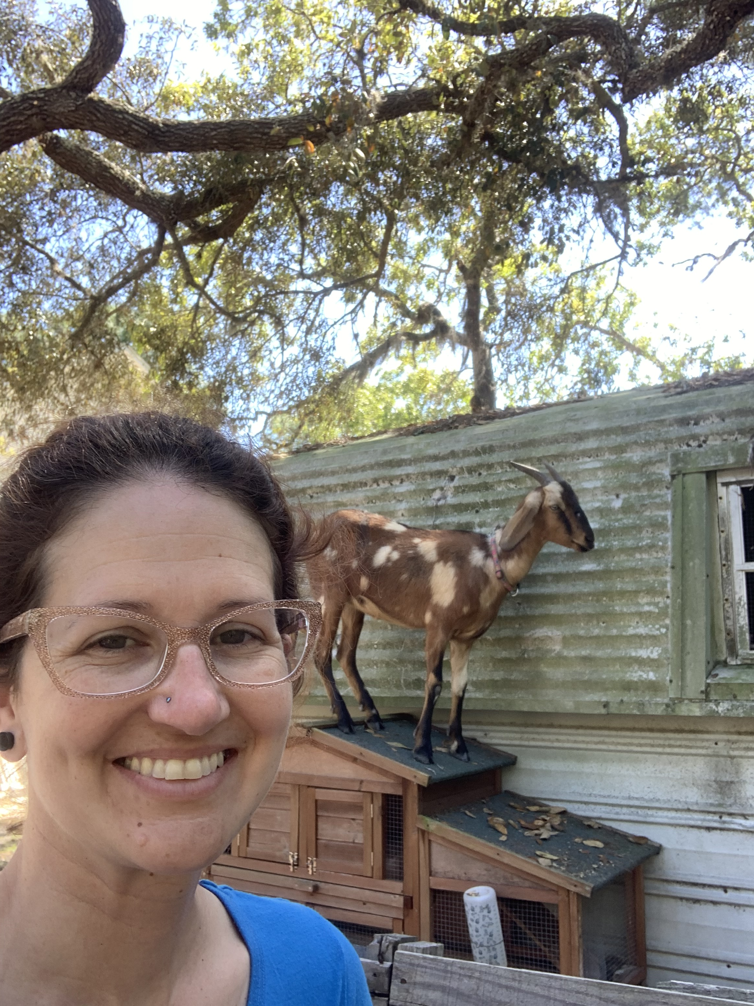
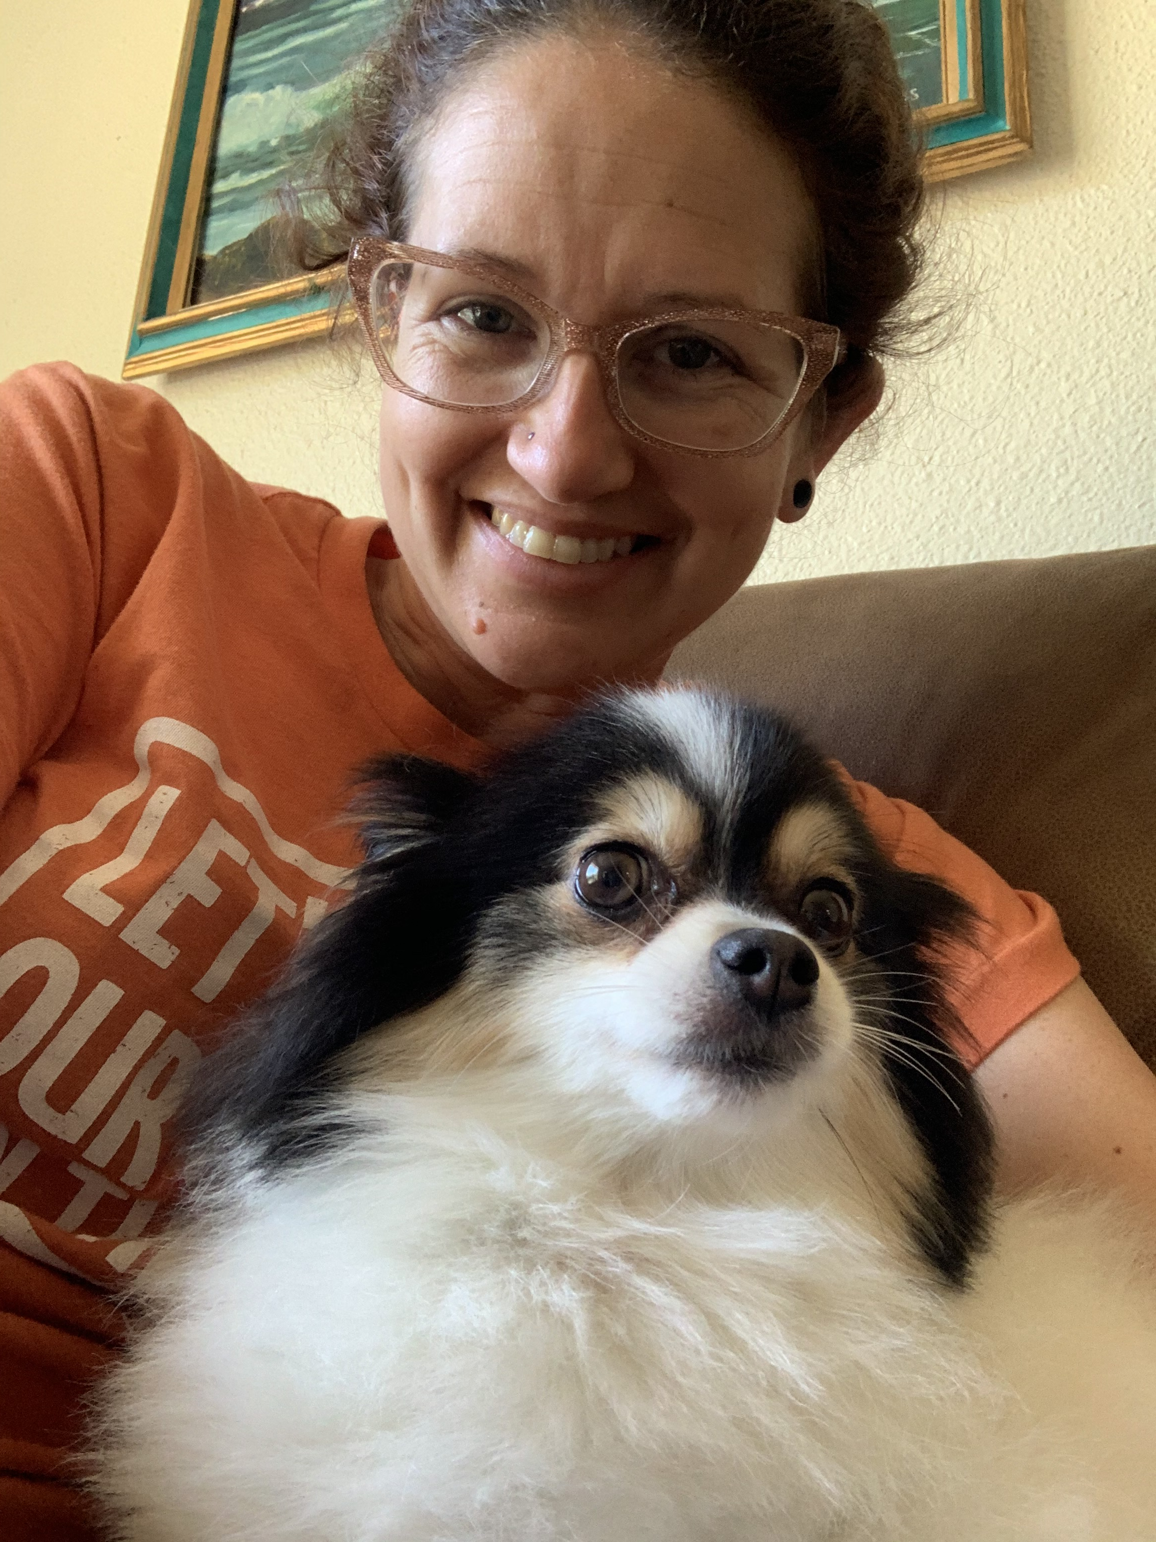
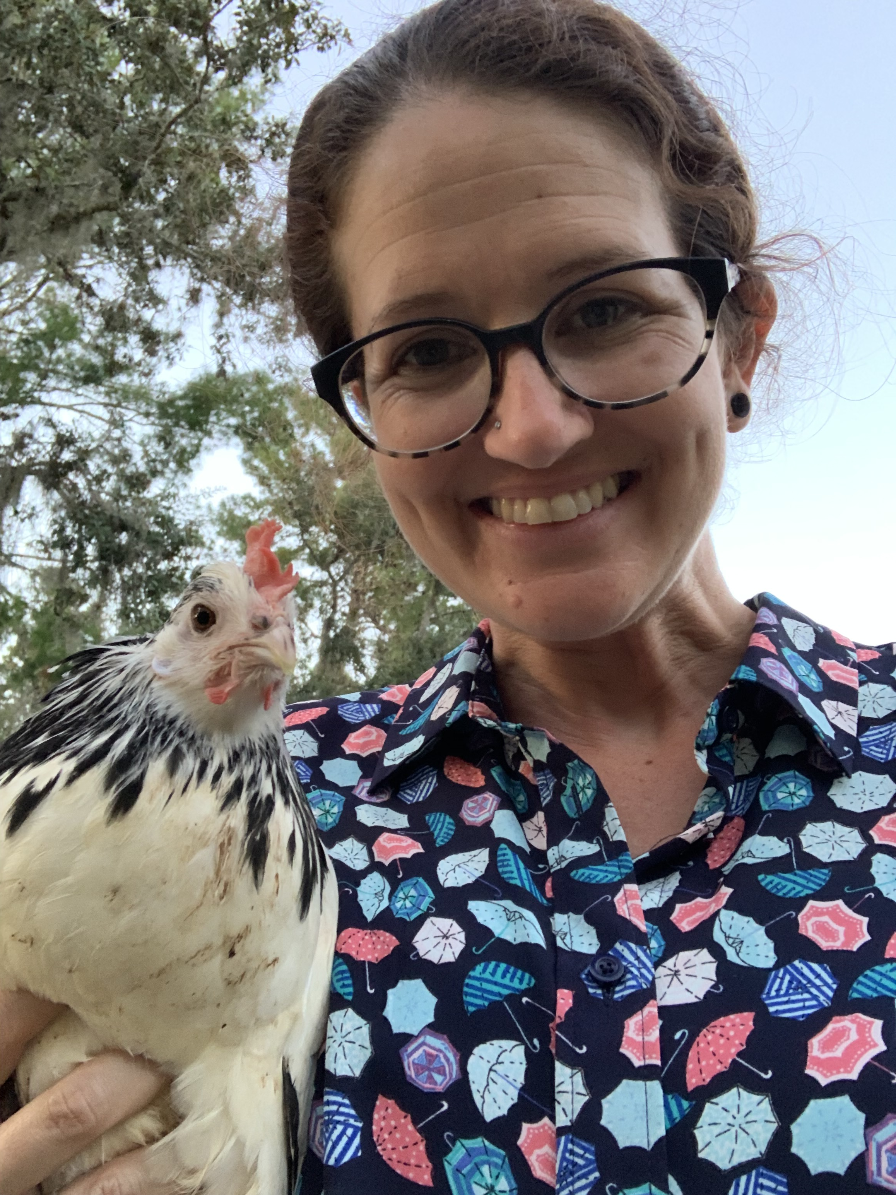
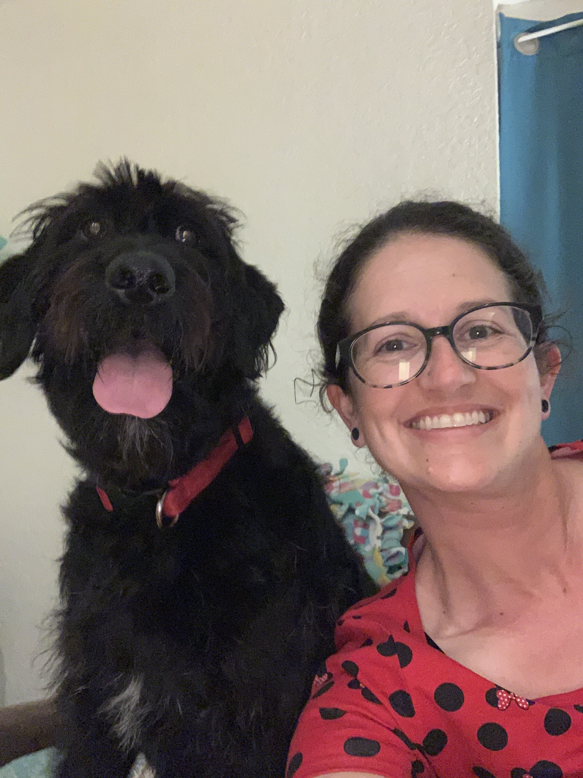
Calling all my animal lovers
One of my all time
favorite past times
is loving on all my
pets.
Do you have
any pets ?
What is your
favorite animal?

Slide 6
Guess my favorite animal?
The live in both cold and warm climates
They are bird but can not fly
They have the most adorable walk
Be prepared if you get up closer they smell a little fishy
Can you figure it out?

Slide 7
Did you guess a Penquin ?

Slide 8
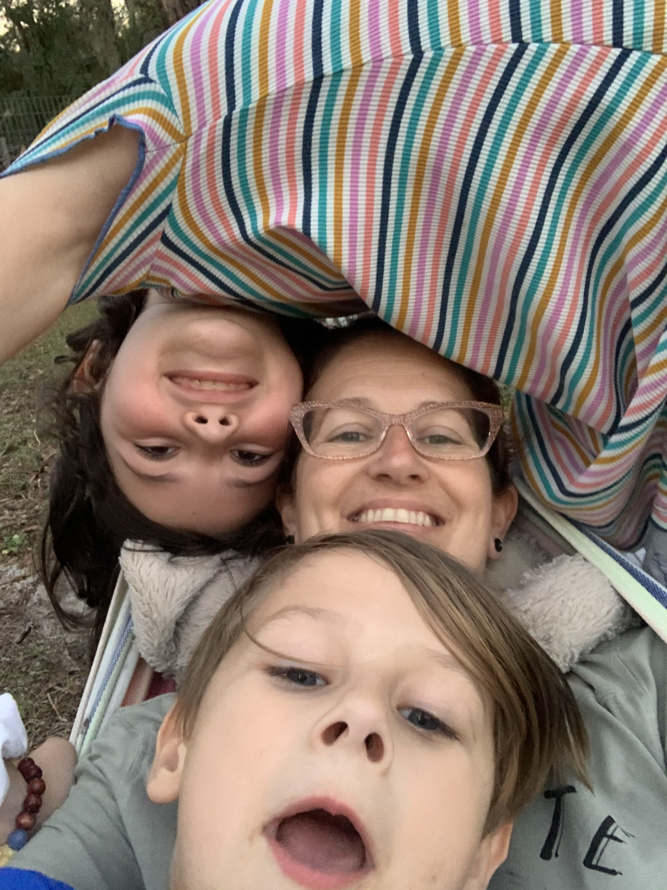
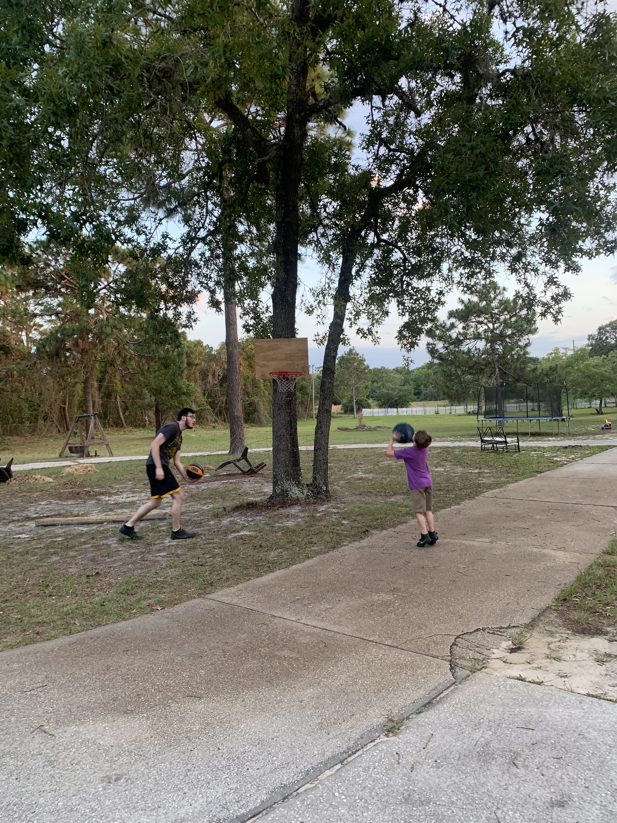
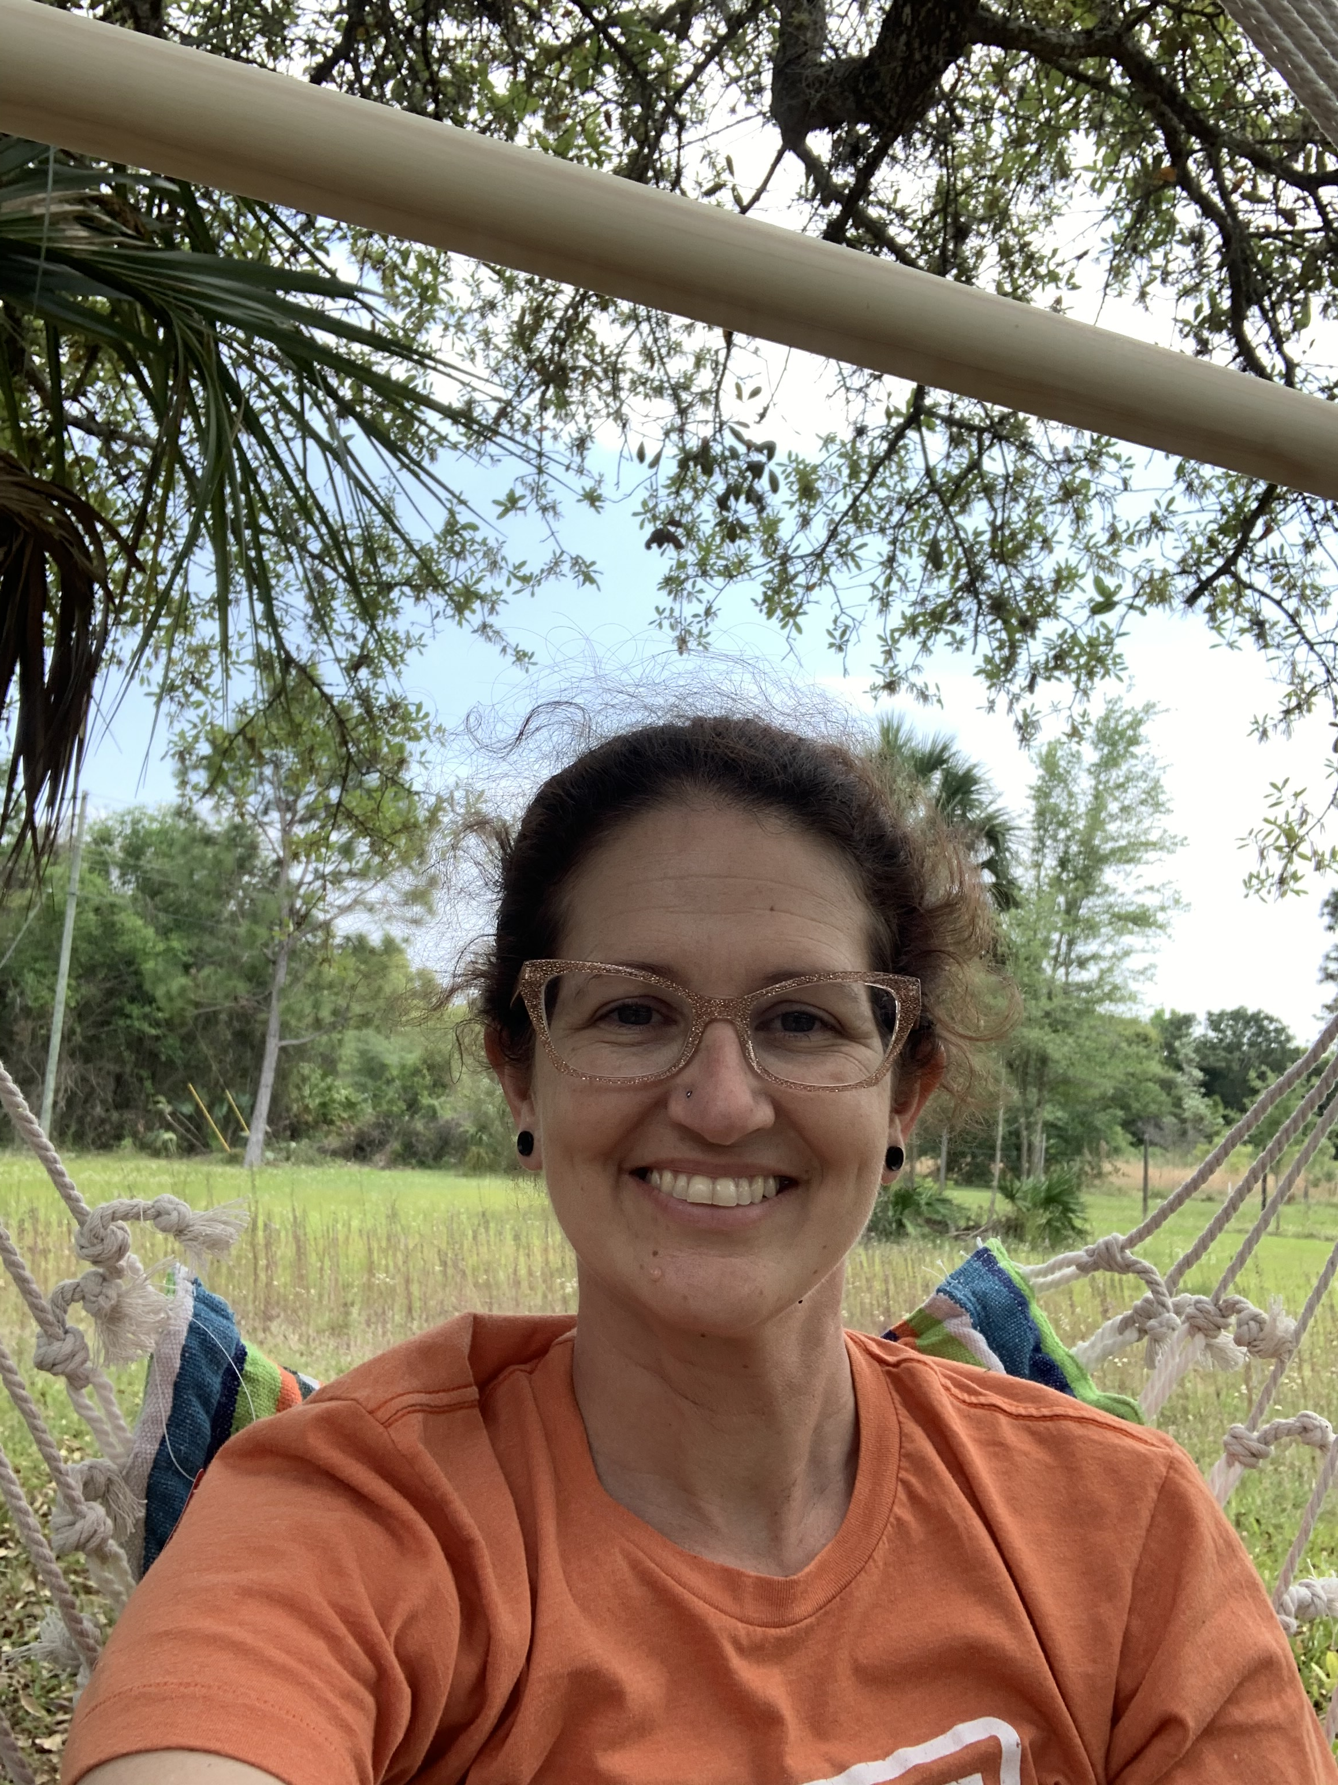
Let’s not forget about staying fit
What are your favorite
outdoor activities?
I love to swing and
play basketball.
Get up and moving !!
Don’t forget to put your
activities on your PE log.

Slide 9
Remember I am still here for you
Please feel free to reach out through mylearning using your inbox
Reach out to set up a meeting through Can We Talk
Call using my google work number at 727-490-8150
Sending Virtual Hugs and Well Wishes

